Slide 1
Dynamic programing for sequence alignment Needleman & Wunsch algorithm
Hassaan Mehboob Awan, Ph.D.
Assistant Professor
Department of Biosciences
COMSATS University Islamabad (CUI)

Slide 2
Dynamic programming
Breaking down a larger problem into smaller sub-problems/tasks
Solves each sub-problem in order to solve the bigger problem
A computational method to find the best optimal alignment between two sequences
The method compares every character in the two sequences and generates an alignment

Slide 3
Components of Alignment
Matches
Mismatches
Gaps
String1: WEAREHUMANS
String2: WEARENOTHUMANZ
WEAREHUMANS
WEARENOTHUMANZ
WEARE HUMANS
WEARENOTHUMANZ
Notes:
Gaps:
Represent insertions or deletions
Used to improve the quality of alignment but represent a naturally occurring biological phenomenon

Slide 4
A1: A TGAG
Query: ATGGCG
A2: ATG AG
Which is the better alignment?

Slide 5
Scoring scheme
There should be some score for matches
There must be a penalty for mismatches
There must be a penalty for gaps
The total score is the sum of all matches and penalties
Total score will reflect the quality of alignment

Slide 6
Scoring scheme:
+1 for every match
-1 for mismatch
0 for gaps
+1+0-1+1-1+1 = 1 
A1: A TGAG
Query: ATGGCG
A2: ATG AG
+1+1+1+0-1+1 = 3

Slide 7


Global vs. Local alignment
Align both sequences end-to-end
Align stretches of sequence with the highest density of matches

Slide 8
Needleman & Wunsch algorithm
Steps:
Initialize N x M matrix
Fill the matrix from upper left corner to the lower right corner in a recursive fashion (using a scoring scheme)
Traceback

Slide 9
Step 1: Initialize table T
i=0 i=1 i=2 i=3 i=4 i=5
m T G G T G
Seq1: TGGTG
Seq2: ATCGT
Seq1 = m
Seq2 = n
J=0 n
J=1 A
J=2 T
J=3 C
J=4 G
J=5 T

Slide 10

Step 1: Initialize table T
i=0 i=1 i=2 i=3 i=4 i=5
m T G G T G
T_{(I,j)} is the cell at the intersection of row I & column j
J=0 n
J=1 A
J=2 T
J=3 C
J=4 G
J=5 T
T_{(4,3)}
Which cell is T(i-1, j-1)
Which cell is T(i,j-1)
Which cell is T(i-1,j)

Slide 11
Step 1: Initialize table T
i=0 i=1 i=2 i=3 i=4 i=5
m T G G T G
J=0 n
J=1 A
J=2 T
J=3 C
J=4 G
J=5 T
0

Slide 12
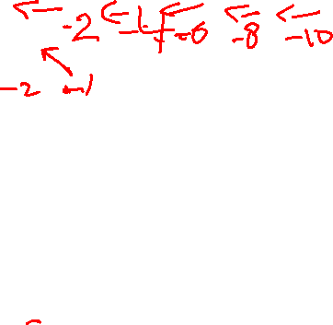
Step 1: Initialize table T
Scoring Scheme
+1 for match
-1 for mismatch
-2 for gap
i=0 i=1 i=2 i=3 i=4 i=5
m T G G T G
J=0 n
J=1 A
J=2 T
J=3 C
J=4 G
J=5 T
0
T_{(i-1, j-1)} + σ (S1_{(i)}, S2_{(j)})
T_{(I,j)} = max T_{(i-1,j)} + gap penalty
T_{(I,j-1)} + gap penalty

Slide 13
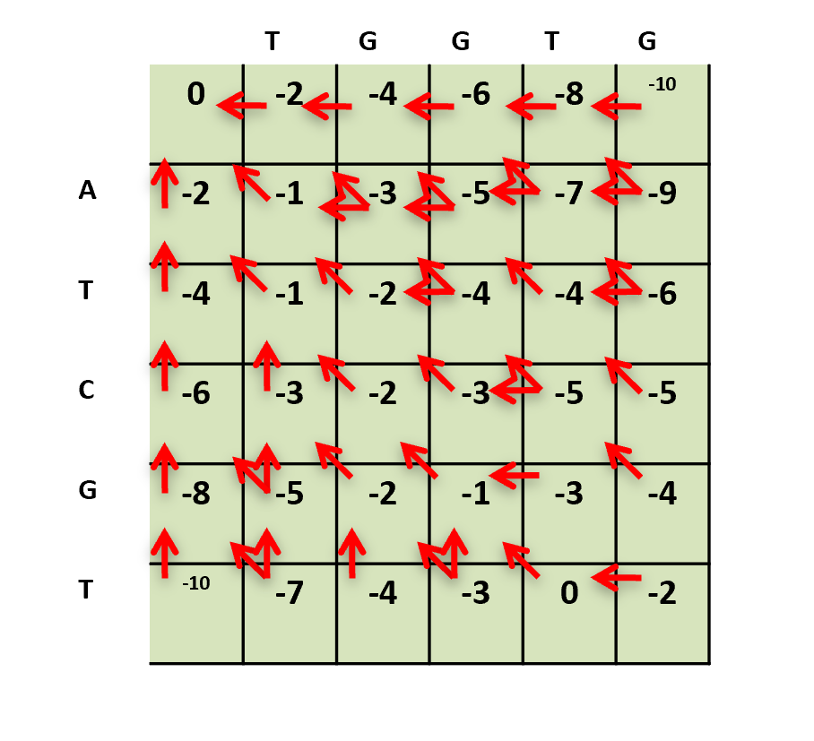

Slide 14
The path through matrix T is the traceback (in pink here):
To work out the best alignment, follow the traceback from top left to bottom right, & look at the letters aligned in each cell
Here the 1st cell doesn’t correspond to any letter
The 2nd cell is ‘A’ in sequence S₂ but nothing in sequence S₁
The 3rd cell is ‘T’ in sequence S₂ and ‘T’ in sequence S₁
The 4th cell is ‘C’ in sequence S₂ and ‘G’ in sequence S₁
The 5th cell is ‘G’ in sequence S₂ and ‘G’ in sequence S₁
The 6th cell is ‘T’ in sequence S₂ and ‘T’ in sequence S₁
The 7th cell is nothing in sequence S₂ and ‘G’ in sequence S₁
sequence S₁
 |  | T | G | G | T | G
 | 0 | -2 | -4 | -6 | -8 | -10
A | -2 | -1 | -3 | -5 | -7 | -9
T | -4 | -1 | -2 | -4 | -4 | -6
C | -6 | -3 | -2 | -3 | -5 | -5
G | -8 | -5 | -2 | -1 | -3 | -4
T | -10 | -7 | -4 | -3 | 0 | -2
 |  | T | G | G | T | G
 | 0 | -2 | -4 | -6 | -8 | -10
A | -2 | -1 | -3 | -5 | -7 | -9
T | -4 | -1 | -2 | -4 | -4 | -6
C | -6 | -3 | -2 | -3 | -5 | -5
G | -8 | -5 | -2 | -1 | -3 | -4
T | -10 | -7 | -4 | -3 | 0 | -2
 |  | T | G | G | T | G
 | 0 | -2 | -4 | -6 | -8 | -10
A | -2 | -1 | -3 | -5 | -7 | -9
T | -4 | -1 | -2 | -4 | -4 | -6
C | -6 | -3 | -2 | -3 | -5 | -5
G | -8 | -5 | -2 | -1 | -3 | -4
T | -10 | -7 | -4 | -3 | 0 | -2
 |  | T | G | G | T | G
 | 0 | -2 | -4 | -6 | -8 | -10
A | -2 | -1 | -3 | -5 | -7 | -9
T | -4 | -1 | -2 | -4 | -4 | -6
C | -6 | -3 | -2 | -3 | -5 | -5
G | -8 | -5 | -2 | -1 | -3 | -4
T | -10 | -7 | -4 | -3 | 0 | -2
 |  | T | G | G | T | G
 | 0 | -2 | -4 | -6 | -8 | -10
A | -2 | -1 | -3 | -5 | -7 | -9
T | -4 | -1 | -2 | -4 | -4 | -6
C | -6 | -3 | -2 | -3 | -5 | -5
G | -8 | -5 | -2 | -1 | -3 | -4
T | -10 | -7 | -4 | -3 | 0 | -2
 |  | T | G | G | T | G
 | 0 | -2 | -4 | -6 | -8 | -10
A | -2 | -1 | -3 | -5 | -7 | -9
T | -4 | -1 | -2 | -4 | -4 | -6
C | -6 | -3 | -2 | -3 | -5 | -5
G | -8 | -5 | -2 | -1 | -3 | -4
T | -10 | -7 | -4 | -3 | 0 | -2
 |  | T | G | G | T | G
 | 0 | -2 | -4 | -6 | -8 | -10
A | -2 | -1 | -3 | -5 | -7 | -9
T | -4 | -1 | -2 | -4 | -4 | -6
C | -6 | -3 | -2 | -3 | -5 | -5
G | -8 | -5 | -2 | -1 | -3 | -4
T | -10 | -7 | -4 | -3 | 0 | -2
 |  | T | G | G | T | G
 | 0 | -2 | -4 | -6 | -8 | -10
A | -2 | -1 | -3 | -5 | -7 | -9
T | -4 | -1 | -2 | -4 | -4 | -6
C | -6 | -3 | -2 | -3 | -5 | -5
G | -8 | -5 | -2 | -1 | -3 | -4
T | -10 | -7 | -4 | -3 | 0 | -2
-
A
T
|
T
G
C
G
|
G
T
|
T
G
-
sequence S₂
Notes:
Horizontal traceback show gap in seq 2
Vertical traceback show gap in seq 1

